Slide 1
Homework 1: Solutions
CS4445/B12
Provided by: Kenneth J. Loomis

Slide 2
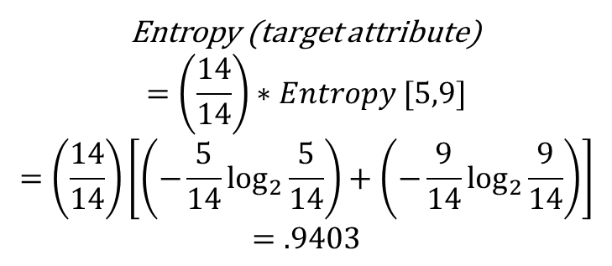
Entropy of the original set
genre | critics-reviews | rating | IMAX | likes
comedy | thumbs-up | R | FALSE | no
comedy | thumbs-up | R | TRUE | no
comedy | neutral | R | FALSE | no
action | thumbs-down | PG-13 | TRUE | no
action | neutral | R | TRUE | no
comedy | thumbs-down | PG-13 | FALSE | yes
comedy | neutral | PG-13 | TRUE | yes
drama | thumbs-up | R | FALSE | yes
drama | thumbs-down | PG-13 | TRUE | yes
drama | neutral | R | TRUE | yes
drama | thumbs-up | PG-13 | FALSE | yes
action | neutral | R | FALSE | yes
action | thumbs-down | PG-13 | FALSE | yes
action | neutral | PG-13 | FALSE | yes
Entropy (target attribute)
$$=\left(\frac{14}{14}\right)∗Entropy [5,9]$$
$$=\left(\frac{14}{14}\right)\left[\left(−\frac{5}{14}\log_{2}{\frac{5}{14}}\right)+\left(−\frac{9}{14}\log_{2}{\frac{9}{14}}\right)\right]$$
$$=.9403$$

Slide 3
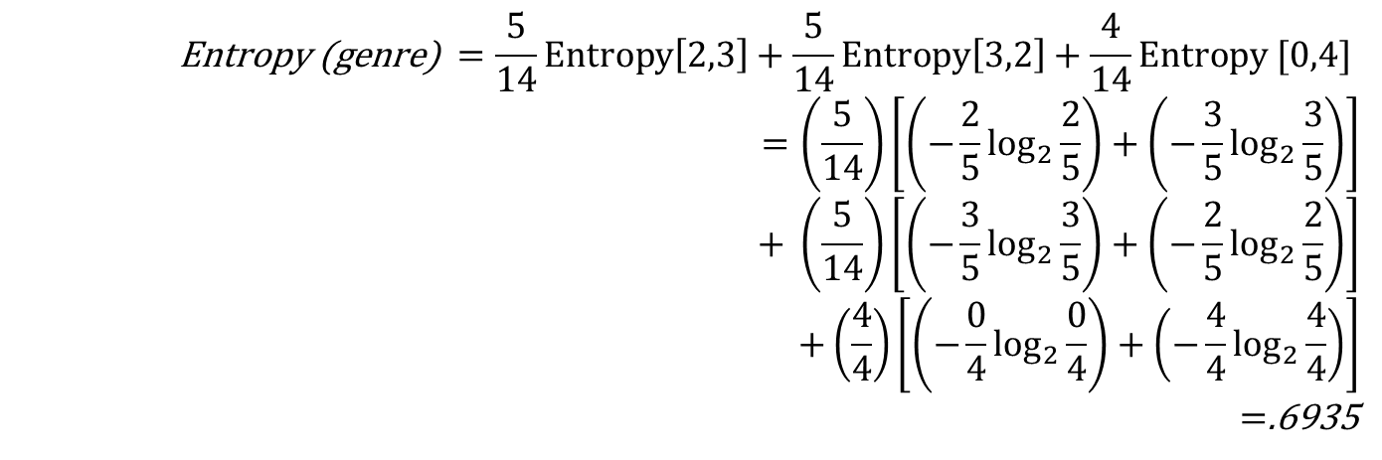
Determine the root node attribute
genre
=comedy
=drama
=action
$$\text{Entropy}\text{ (}\text{genre}\text{) }=\frac{5}{14}Entropy\left[2,3\right]+\frac{5}{14}Entropy\left[3,2\right]+\frac{4}{14}Entropy [0,4]$$
$$=\left(\frac{5}{14}\right)\left[\left(−\frac{2}{5}\log_{2}{\frac{2}{5}}\right)+\left(−\frac{3}{5}\log_{2}{\frac{3}{5}}\right)\right]$$
$$+ \left(\frac{5}{14}\right)\left[\left(−\frac{3}{5}\log_{2}{\frac{3}{5}}\right)+\left(−\frac{2}{5}\log_{2}{\frac{2}{5}}\right)\right]$$
$$+\left(\frac{4}{4}\right)\left[\left(−\frac{0}{4}\log_{2}{\frac{0}{4}}\right)+\left(−\frac{4}{4}\log_{2}{\frac{4}{4}}\right)\right]$$
$=$.6935
genre | critics-reviews | rating | IMAX | likes
action | thumbs-down | PG-13 | TRUE | no
action | neutral | R | TRUE | no
action | neutral | R | FALSE | yes
action | thumbs-down | PG-13 | FALSE | yes
action | neutral | PG-13 | FALSE | yes
comedy | thumbs-up | R | FALSE | no
comedy | thumbs-up | R | TRUE | no
comedy | neutral | R | FALSE | no
comedy | thumbs-down | PG-13 | FALSE | yes
comedy | neutral | PG-13 | TRUE | yes
drama | thumbs-up | R | FALSE | yes
drama | thumbs-down | PG-13 | TRUE | yes
drama | neutral | R | TRUE | yes
drama | thumbs-up | PG-13 | FALSE | yes

Slide 4
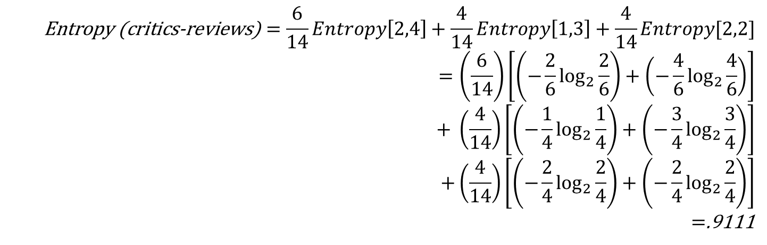
Determine the root node attribute
critics-reviews
=neutral
=thumbs-down
=thumbs-up
$$\text{Entropy}\text{ (}\text{critics}\text{−}\text{reviews}\text{)}=\frac{6}{14}Entropy\left[2,4\right]+\frac{4}{14}Entropy\left[1,3\right]+\frac{4}{14}Entropy[2,2]$$
$$=\left(\frac{6}{14}\right)\left[\left(−\frac{2}{6}\log_{2}{\frac{2}{6}}\right)+\left(−\frac{4}{6}\log_{2}{\frac{4}{6}}\right)\right]$$
$$+ \left(\frac{4}{14}\right)\left[\left(−\frac{1}{4}\log_{2}{\frac{1}{4}}\right)+\left(−\frac{3}{4}\log_{2}{\frac{3}{4}}\right)\right]$$
$$+\left(\frac{4}{14}\right)\left[\left(−\frac{2}{4}\log_{2}{\frac{2}{4}}\right)+\left(−\frac{2}{4}\log_{2}{\frac{2}{4}}\right)\right]$$
$=$.9111
genre | critics-reviews | rating | IMAX | likes
action | neutral | R | TRUE | no
comedy | neutral | R | FALSE | no
action | neutral | R | FALSE | yes
action | neutral | PG-13 | FALSE | yes
comedy | neutral | PG-13 | TRUE | yes
drama | neutral | R | TRUE | yes
action | thumbs-down | PG-13 | TRUE | no
action | thumbs-down | PG-13 | FALSE | yes
comedy | thumbs-down | PG-13 | FALSE | yes
drama | thumbs-down | PG-13 | TRUE | yes
comedy | thumbs-up | R | FALSE | no
comedy | thumbs-up | R | TRUE | no
drama | thumbs-up | R | FALSE | yes
drama | thumbs-up | PG-13 | FALSE | yes

Slide 5
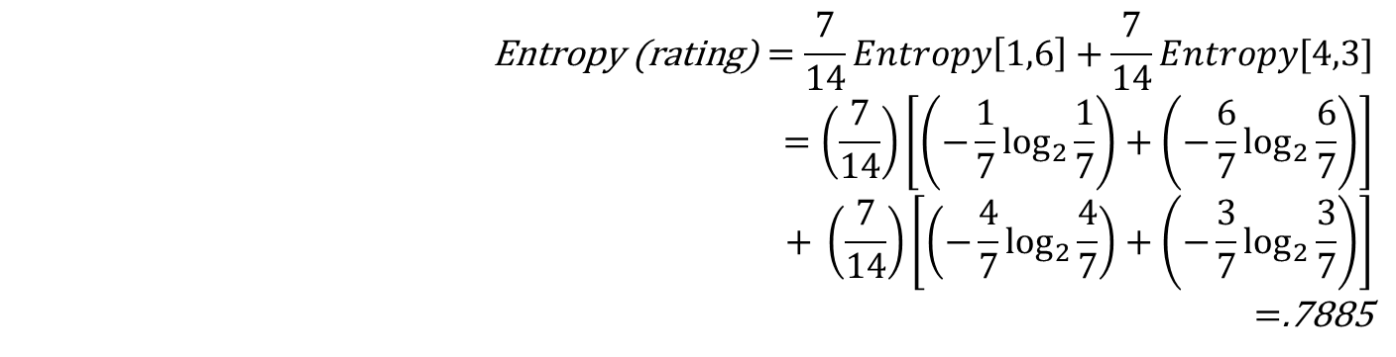
Determine the root node attribute
rating
=R
=PG-13
$$\text{Entropy}\text{ (}\text{rating}\text{)}=\frac{7}{14}Entropy\left[1,6\right]+\frac{7}{14}Entropy[4,3]$$
$$=\left(\frac{7}{14}\right)\left[\left(−\frac{1}{7}\log_{2}{\frac{1}{7}}\right)+\left(−\frac{6}{7}\log_{2}{\frac{6}{7}}\right)\right]$$
$$+ \left(\frac{7}{14}\right)\left[\left(−\frac{4}{7}\log_{2}{\frac{4}{7}}\right)+\left(−\frac{3}{7}\log_{2}{\frac{3}{7}}\right)\right]$$
$=$.7885
genre | critics-reviews | rating | IMAX | likes
action | thumbs-down | PG-13 | TRUE | no
action | neutral | PG-13 | FALSE | yes
comedy | neutral | PG-13 | TRUE | yes
action | thumbs-down | PG-13 | FALSE | yes
comedy | thumbs-down | PG-13 | FALSE | yes
drama | thumbs-down | PG-13 | TRUE | yes
drama | thumbs-up | PG-13 | FALSE | yes
action | neutral | R | TRUE | no
comedy | neutral | R | FALSE | no
comedy | thumbs-up | R | FALSE | no
comedy | thumbs-up | R | TRUE | no
action | neutral | R | FALSE | yes
drama | neutral | R | TRUE | yes
drama | thumbs-up | R | FALSE | yes

Slide 6
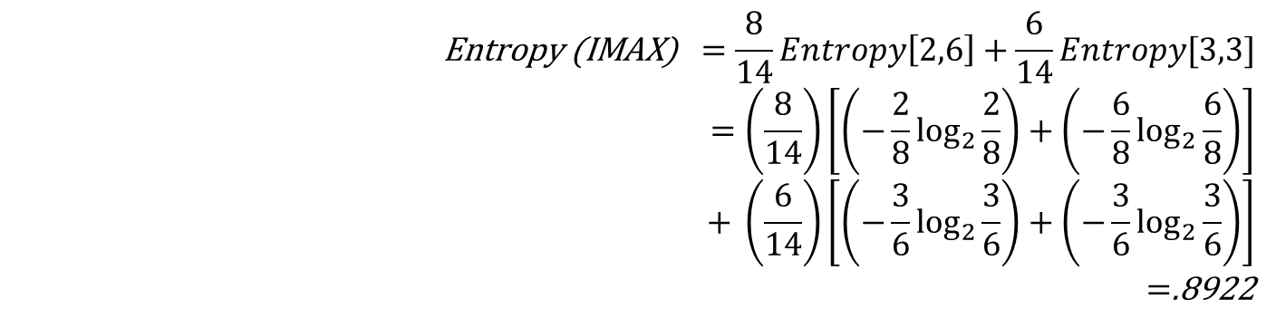
Determine the root node attribute
IMAX
=TRUE
=FALSE
$$\text{Entropy}\text{ (}\text{IMAX}\text{)} =\frac{8}{14}Entropy\left[2,6\right]+\frac{6}{14}Entropy[3,3]$$
$$=\left(\frac{8}{14}\right)\left[\left(−\frac{2}{8}\log_{2}{\frac{2}{8}}\right)+\left(−\frac{6}{8}\log_{2}{\frac{6}{8}}\right)\right]$$
$$+ \left(\frac{6}{14}\right)\left[\left(−\frac{3}{6}\log_{2}{\frac{3}{6}}\right)+\left(−\frac{3}{6}\log_{2}{\frac{3}{6}}\right)\right]$$
$=$.8922
genre | critics-reviews | rating | IMAX | likes
comedy | neutral | R | FALSE | no
comedy | thumbs-up | R | FALSE | no
action | neutral | PG-13 | FALSE | yes
action | thumbs-down | PG-13 | FALSE | yes
comedy | thumbs-down | PG-13 | FALSE | yes
drama | thumbs-up | PG-13 | FALSE | yes
action | neutral | R | FALSE | yes
drama | thumbs-up | R | FALSE | yes
action | thumbs-down | PG-13 | TRUE | no
action | neutral | R | TRUE | no
comedy | thumbs-up | R | TRUE | no
comedy | neutral | PG-13 | TRUE | yes
drama | thumbs-down | PG-13 | TRUE | yes
drama | neutral | R | TRUE | yes

Slide 7
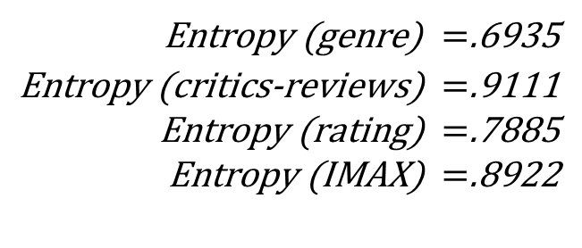
Determine the root node attribute
genre
=comedy
=drama
=action
$\text{Entropy}\text{ (}\text{genre}\text{)} =$.6935
$\text{Entropy}\text{ (}\text{critics}\text{−}\text{reviews}\text{)} =$.9111
$\text{Entropy}\text{ (}\text{rating}\text{)} =$.7885
$\text{Entropy}\text{ (}\text{IMAX}\text{)} =$.8922
We can see that genre provides us with the lowest entropy, thus it becomes the root node of our ID3 tree.

Slide 8
Determine the left child attribute
genre
=comedy
=drama
=action
?
We now move on to the left child node of our tree. What attribute do we choose for this node?
Options:
critics-reviews
rating
IMAX

Slide 9
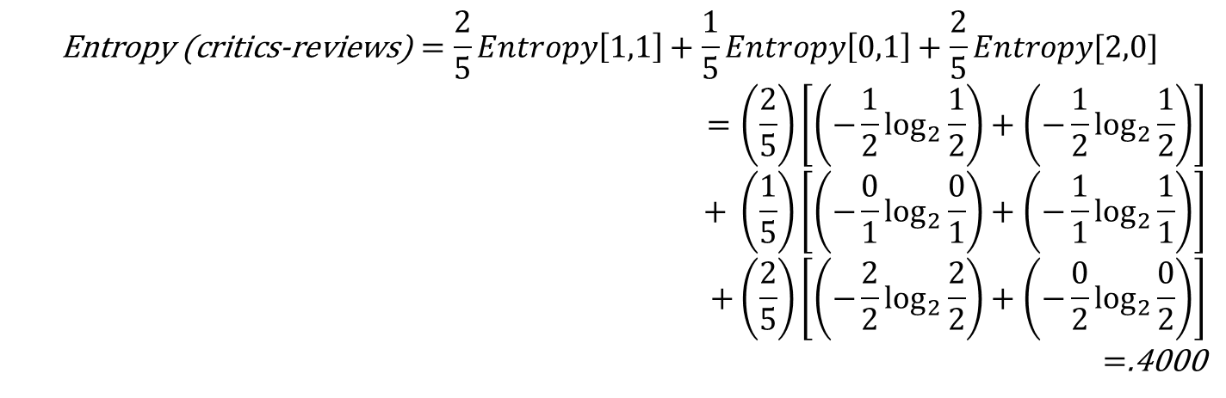
Determine the left child attribute
genre
=comedy
=drama
=action
critics-reviews
=neutral
=thumbs-down
=thumbs-up
$$\text{Entropy}\text{ (}\text{critics}\text{−}\text{reviews}\text{)}=\frac{2}{5}Entropy\left[1,1\right]+\frac{1}{5}Entropy\left[0,1\right]+\frac{2}{5}Entropy[2,0]$$
$$=\left(\frac{2}{5}\right)\left[\left(−\frac{1}{2}\log_{2}{\frac{1}{2}}\right)+\left(−\frac{1}{2}\log_{2}{\frac{1}{2}}\right)\right]$$
$$+ \left(\frac{1}{5}\right)\left[\left(−\frac{0}{1}\log_{2}{\frac{0}{1}}\right)+\left(−\frac{1}{1}\log_{2}{\frac{1}{1}}\right)\right]$$
$$+\left(\frac{2}{5}\right)\left[\left(−\frac{2}{2}\log_{2}{\frac{2}{2}}\right)+\left(−\frac{0}{2}\log_{2}{\frac{0}{2}}\right)\right]$$
$=$.4000
genre | critics-reviews | rating | IMAX | likes
comedy | neutral | R | FALSE | no
comedy | neutral | PG-13 | TRUE | yes
comedy | thumbs-down | PG-13 | FALSE | yes
comedy | thumbs-up | R | FALSE | no
comedy | thumbs-up | R | TRUE | no

Slide 10
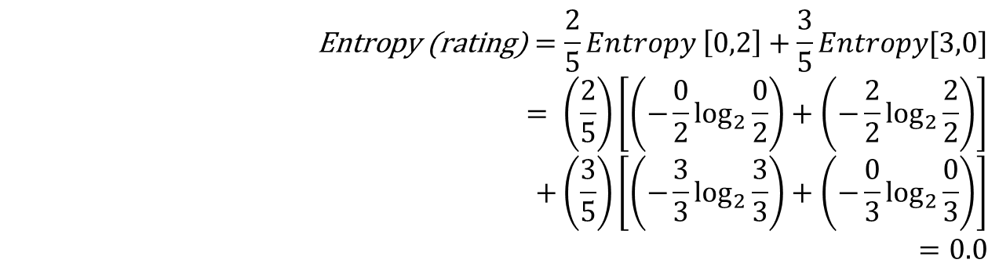
Determine the left child attribute
genre
=comedy
=drama
=action
rating
=PG-13
=R
$$\text{Entropy}\text{ (}\text{rating}\text{)}=\frac{2}{5}Entropy \left[0,2\right]+\frac{3}{5}Entropy[3,0]$$
$$= \left(\frac{2}{5}\right)\left[\left(−\frac{0}{2}\log_{2}{\frac{0}{2}}\right)+\left(−\frac{2}{2}\log_{2}{\frac{2}{2}}\right)\right]$$
$$+\left(\frac{3}{5}\right)\left[\left(−\frac{3}{3}\log_{2}{\frac{3}{3}}\right)+\left(−\frac{0}{3}\log_{2}{\frac{0}{3}}\right)\right]$$
$$=0.0$$
genre | critics-reviews | rating | IMAX | likes
comedy | neutral | PG-13 | TRUE | yes
comedy | thumbs-down | PG-13 | FALSE | yes
comedy | neutral | R | FALSE | no
comedy | thumbs-up | R | FALSE | no
comedy | thumbs-up | R | TRUE | no

Slide 11
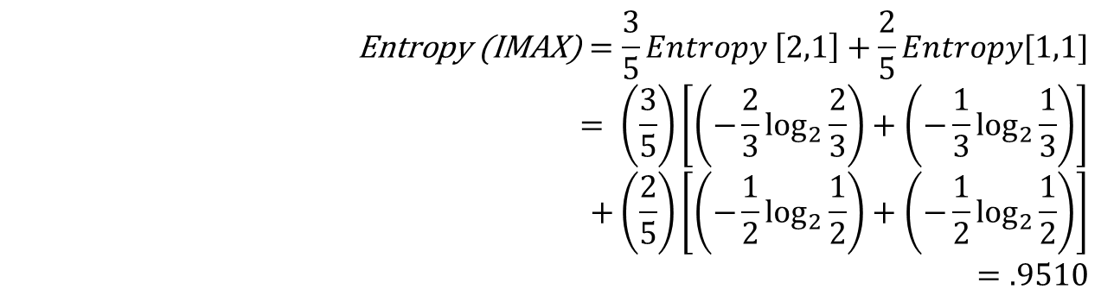
Determine the left child attribute
genre
=comedy
=drama
=action
IMAX
=PG-13
=R
$$\text{Entropy}\text{ (}\text{IMAX}\text{)}=\frac{3}{5}Entropy \left[2,1\right]+\frac{2}{5}Entropy[1,1]$$
$$= \left(\frac{3}{5}\right)\left[\left(−\frac{2}{3}\log_{2}{\frac{2}{3}}\right)+\left(−\frac{1}{3}\log_{2}{\frac{1}{3}}\right)\right]$$
$$+\left(\frac{2}{5}\right)\left[\left(−\frac{1}{2}\log_{2}{\frac{1}{2}}\right)+\left(−\frac{1}{2}\log_{2}{\frac{1}{2}}\right)\right]$$
$$=.9510$$
genre | critics-reviews | rating | IMAX | likes
comedy | neutral | R | FALSE | no
comedy | thumbs-up | R | FALSE | no
comedy | thumbs-down | PG-13 | FALSE | yes
comedy | thumbs-up | R | TRUE | no
comedy | neutral | PG-13 | TRUE | yes

Slide 12
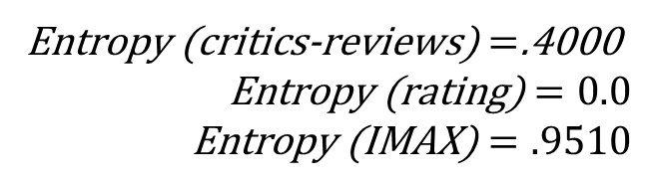
Determine the left child attribute
genre
=comedy
=drama
=action
rating
=PG-13
=R
We can see that rating provides us with the lowest entropy, thus it becomes the left child node of our ID3 tree.
$\text{Entropy}\text{ (}\text{critics}\text{−}\text{reviews}\text{)}=$.4000
$$\text{Entropy}\text{ (}\text{rating}\text{)}=0.0$$
$$\text{Entropy}\text{ (}\text{IMAX}\text{)}=.9510$$

Slide 13
Determine the left child attribute
genre
=comedy
=drama
=action
rating
=PG-13
=R
[yes]
[no]
genre | critics-reviews | rating | IMAX | likes
comedy | neutral | PG-13 | TRUE | yes
comedy | thumbs-down | PG-13 | FALSE | yes
comedy | neutral | R | FALSE | no
comedy | thumbs-up | R | FALSE | no
comedy | thumbs-up | R | TRUE | no
This also makes this split homogeneous so we can add our leaf nodes here.

Slide 14
Determine the center child attribute
genre
=comedy
=action
=drama
rating
[yes]
=PG-13
=R
[yes]
[no]
We can see that genre = drama provides us with a homogeneous sub-set, so we can provide a leaf node here.
genre | critics-reviews | rating | IMAX | likes
drama | thumbs-up | R | FALSE | yes
drama | thumbs-down | PG-13 | TRUE | yes
drama | neutral | R | TRUE | yes
drama | thumbs-up | PG-13 | FALSE | yes

Slide 15
Determine the right child attribute
genre
=comedy
=action
=drama
rating
[yes]
?
=PG-13
=R
[yes]
[no]
Options:
critics-reviews
rating
IMAX
We now move on to the right child node of our tree. What attribute do we choose for this node?

Slide 16
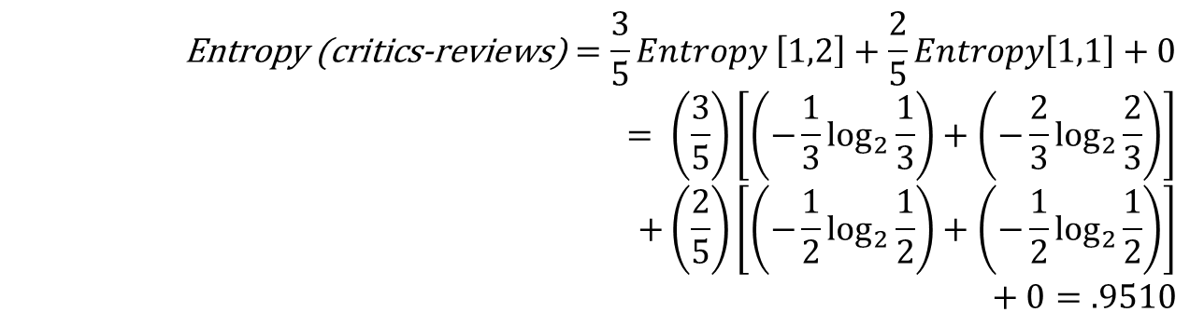
Determine the right child attribute
genre
=comedy
=action
=drama
rating
[yes]
Critics-reviews
=PG-13
=R
=neutral
=thumbs-up
=thumbs-down
[yes]
[no]
$$\text{Entropy}\text{ (}\text{critics}\text{−}\text{reviews}\text{)}=\frac{3}{5}Entropy \left[1,2\right]+\frac{2}{5}Entropy\left[1,1\right]+0$$
$$= \left(\frac{3}{5}\right)\left[\left(−\frac{1}{3}\log_{2}{\frac{1}{3}}\right)+\left(−\frac{2}{3}\log_{2}{\frac{2}{3}}\right)\right]$$
$$+\left(\frac{2}{5}\right)\left[\left(−\frac{1}{2}\log_{2}{\frac{1}{2}}\right)+\left(−\frac{1}{2}\log_{2}{\frac{1}{2}}\right)\right]$$
$$+ 0=.9510$$
genre | critics-reviews | rating | IMAX | likes
action | neutral | R | TRUE | no
action | neutral | R | FALSE | yes
action | neutral | PG-13 | FALSE | yes
action | thumbs-down | PG-13 | TRUE | no
action | thumbs-down | PG-13 | FALSE | yes

Slide 17
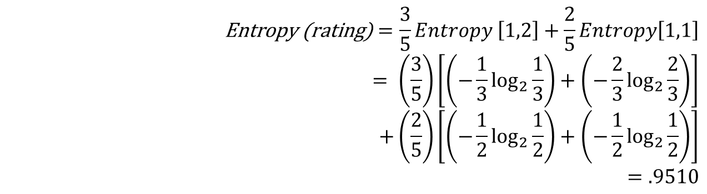
Determine the right child attribute
genre
=comedy
=action
=drama
rating
[yes]
rating
=PG-13
=R
=PG-13
=R
[yes]
[no]
$$\text{Entropy}\text{ (}\text{rating}\text{)}=\frac{3}{5}Entropy \left[1,2\right]+\frac{2}{5}Entropy\left[1,1\right]$$
$$= \left(\frac{3}{5}\right)\left[\left(−\frac{1}{3}\log_{2}{\frac{1}{3}}\right)+\left(−\frac{2}{3}\log_{2}{\frac{2}{3}}\right)\right]$$
$$+\left(\frac{2}{5}\right)\left[\left(−\frac{1}{2}\log_{2}{\frac{1}{2}}\right)+\left(−\frac{1}{2}\log_{2}{\frac{1}{2}}\right)\right]$$
$$=.9510$$
genre | critics-reviews | rating | IMAX | likes
action | thumbs-down | PG-13 | TRUE | no
action | neutral | PG-13 | FALSE | yes
action | thumbs-down | PG-13 | FALSE | yes
action | neutral | R | TRUE | no
action | neutral | R | FALSE | yes

Slide 18
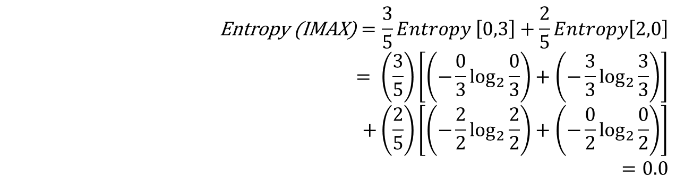
Determine the right child attribute
genre
=comedy
=action
=drama
rating
[yes]
IMAX
=PG-13
=R
=FALSE
=TRUE
[yes]
[no]
$$\text{Entropy}\text{ (}\text{IMAX}\text{)}=\frac{3}{5}Entropy \left[0,3\right]+\frac{2}{5}Entropy\left[2,0\right]$$
$$= \left(\frac{3}{5}\right)\left[\left(−\frac{0}{3}\log_{2}{\frac{0}{3}}\right)+\left(−\frac{3}{3}\log_{2}{\frac{3}{3}}\right)\right]$$
$$+\left(\frac{2}{5}\right)\left[\left(−\frac{2}{2}\log_{2}{\frac{2}{2}}\right)+\left(−\frac{0}{2}\log_{2}{\frac{0}{2}}\right)\right]$$
$$=0.0$$
genre | critics-reviews | rating | IMAX | likes
action | neutral | PG-13 | FALSE | yes
action | thumbs-down | PG-13 | FALSE | yes
action | neutral | R | FALSE | yes
action | thumbs-down | PG-13 | TRUE | no
action | neutral | R | TRUE | no

Slide 19
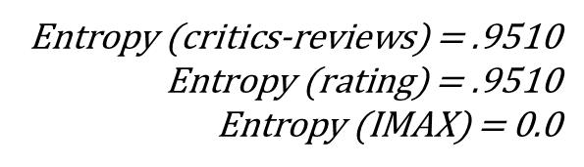
Determine the right child attribute
genre
=comedy
=action
=drama
rating
[yes]
IMAX
=PG-13
=R
=FALSE
=TRUE
[yes]
[no]
We can see that IMAX provides us with the lowest entropy, thus it becomes the right child node of our ID3 tree.
Entropy (critics-reviews) = .9510
$\text{Entropy}\text{ (}\text{rating}\text{)}$ = .9510
Entropy (IMAX) = 0.0

Slide 20
Determine the right child attribute
genre
=comedy
=action
=drama
rating
[yes]
IMAX
=PG-13
=R
=FALSE
=TRUE
[yes]
[no]
[yes]
[no]
This also makes this split homogeneous so we can add our leaf nodes here.
genre | critics-reviews | rating | IMAX | likes
action | neutral | PG-13 | FALSE | yes
action | thumbs-down | PG-13 | FALSE | yes
action | neutral | R | FALSE | yes
action | thumbs-down | PG-13 | TRUE | no
action | neutral | R | TRUE | no

Slide 21
ID3 Decision tree is complete
genre
=comedy
=action
=drama
rating
[yes]
IMAX
=PG-13
=R
=FALSE
=TRUE
[yes]
[no]
[yes]
[no]
Since we have only leaf nodes remaining we are finished building our tree.

Slide 22
Handling missing values during prediction
genre
=comedy
=action
=drama
rating
[yes]
IMAX
=PG-13
=R
=FALSE
=TRUE
[yes]
[no]
[yes]
[no]
Given an instance:
Genre = action
Critics-reviews = ?
Rating = R
IMAX = ?
How do we classify it?
How can we handle missing values using this decision tree?

Slide 23
Handling missing values during prediction: a solution
Consider adding frequency counts to each leaf node:
shown here in curly braces.
genre
=comedy
=action
=drama
rating
[yes] {4}
IMAX
=PG-13
=R
=FALSE
=TRUE
[yes] {2}
[no] {3}
[yes] {3}
[no] {2}

Slide 24
Handling missing values during prediction: a solution
genre
=comedy
=action
=drama
rating
[yes] {4}
IMAX
=PG-13
=R
=FALSE
=TRUE
[yes] {2}
[no] {3}
[yes] {3}
[no] {2}
Genre = action
Critics-reviews = ?
Rating = R
IMAX = ?
Traverse the tree.

Slide 25
Handling missing values during prediction: a solution
genre
=comedy
=action
=drama
rating
[yes] {4}
IMAX
=PG-13
=R
=FALSE
=TRUE
[yes] {2}
[no] {3}
[yes] {3}
[no] {2}
Genre = action
Critics-reviews = ?
Rating = R
IMAX = ?
Traverse the decision tree normally when the attribute value is known.

Slide 26
Handling missing values during prediction: a solution
genre
=comedy
=action
=drama
rating
[yes] {4}
IMAX
=PG-13
=R
=FALSE
=TRUE
[yes] {2}
[no] {3}
[yes] {3}
[no] {2}
Genre = action
Critics-reviews = ?
Rating = R
IMAX = ?
Traverse every possible path when a missing value is encountered.

Slide 27
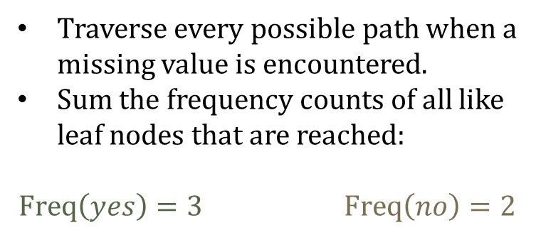
Handling missing values during prediction: a solution
genre
=comedy
=action
=drama
rating
[yes] {4}
IMAX
=PG-13
=R
=FALSE
=TRUE
[yes] {2}
[no] {3}
[yes] {3}
[no] {2}
Traverse every possible path when a missing value is encountered.
Sum the frequency counts of all like leaf nodes that are reached:
$$\operatorname{Freq}\left(yes\right)=3 \operatorname{Freq}\left(no\right)=2$$
Genre = action
Critics-reviews = ?
Rating = R
IMAX = ?

Slide 28
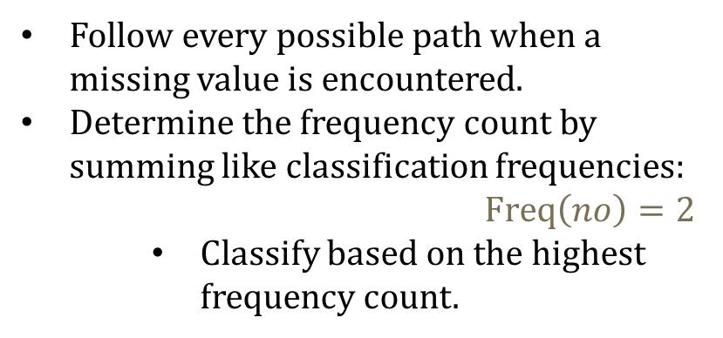
Handling missing values during prediction: a solution
genre
=comedy
=action
=drama
rating
[yes] {4}
IMAX
=PG-13
=R
=FALSE
=TRUE
[yes] {2}
[no] {3}
[yes] {3}
[no] {2}
Follow every possible path when a missing value is encountered.
Determine the frequency count by summing like classification frequencies:
$$\operatorname{Freq}\left(yes\right)=3 \operatorname{Freq}\left(no\right)=2$$
Classify based on the highest frequency count.
Genre = action
Critics-reviews = ?
Rating = R
IMAX = ?
like = yes

Slide 29
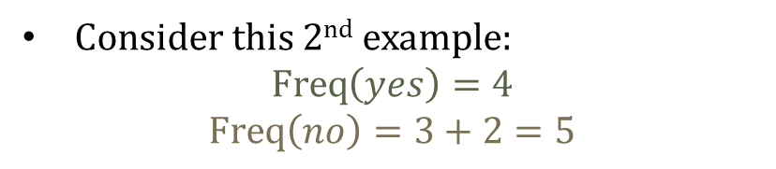
Handling missing values during prediction: 2nd example
genre
=comedy
=action
=drama
rating
[yes] {4}
IMAX
=PG-13
=R
=FALSE
=TRUE
[yes] {2}
[no] {3}
[yes] {3}
[no] {2}
Genre = ?
Critics-reviews = ?
Rating = R
IMAX = TRUE
like = no
Consider this 2nd example:
$$\operatorname{Freq}\left(yes\right)=4$$
$$\operatorname{Freq}\left(no\right)=3+2=5$$

Slide 30
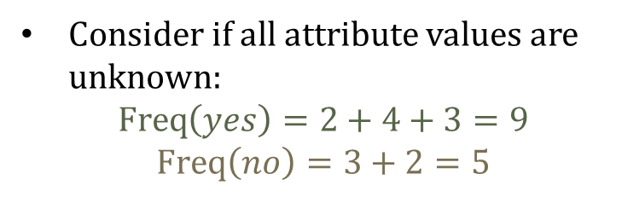
Handling missing values during prediction: 3rd example
genre
=comedy
=action
=drama
rating
[yes] {4}
IMAX
=PG-13
=R
=FALSE
=TRUE
[yes] {2}
[no] {3}
[yes] {3}
[no] {2}
Genre = ?
Critics-reviews = ?
Rating = ?
IMAX = ?
likes = yes
Consider if all attribute values are unknown:
$$\operatorname{Freq}\left(yes\right)=2+4+3=9$$
$$\operatorname{Freq}\left(no\right)=3+2=5$$

